Slide 1
SafeSchool - Promoting students’ engagement in the prevention of bullying in schools
2nd Trasnational Meeting
24th – 25th July 2018
Matosinhos, Portugal

Slide 2
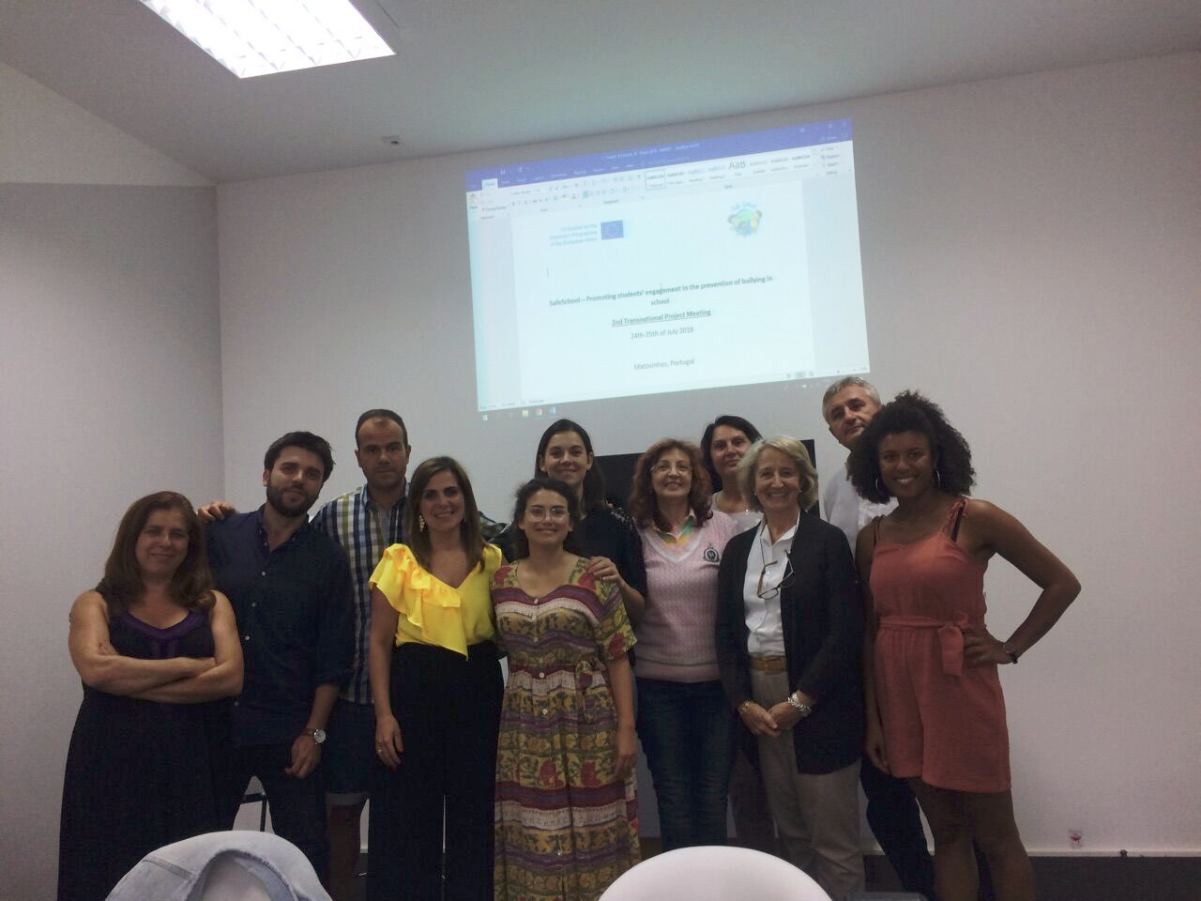
The Team – Matosinhos, Portugal

